Slide 1
1,000,000
STUDENTS
#ABE1M

Slide 2
1,000,000
STUDENTS
#ABE1M

Slide 3
CELEBRATING
1 MILLION
ABE STUDENTS
#ABE1M

Slide 4
CELEBRATING
1 MILLION
ABE STUDENTS

Slide 5
CELEBRATING
1 MILLION
ABE STUDENTS

Slide 6
#ABE1M

Slide 7
QUOTES
[INSERT YOUR MEMORABLE QUOTE HERE!]
[YOUR NAME]
(JOB, LOCATION)

Slide 8
PRINTABLE PROPS:
These can be printed on paper or card-stock, cut out and used as photo props,
like you might see in a photo-booth at a wedding or other event

Slide 9
1M
ABE

Slide 10
34
27
1M
YEARS

Slide 11
ABE
1M

Slide 14
Social Media-style frame.
This could be printed on a large sheet so people can put their faces in it

Slide 15
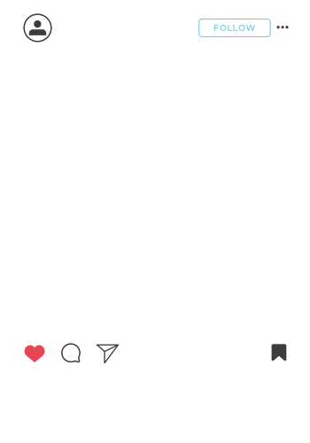
@ABE_Program_Office
#ABE1M

